Slide 1

Lernen
Presented By: BigData

Slide 2
Table of contents
01
02
03
04
05
06
Lernen Overview
Lernen’s Plan
Functional Use Cases
Relational Model
Tech Stack
Ending off with Q&A

Slide 3

Overview
An application that allows students to choose classes from various professors and departments
Targets for students and professors
Paired with a user friendly frontend for easy navigation
React
Tableau
PostgreSQL database for data storage of courses

Slide 4
75% of college students procrastinate

Slide 5
Lernen’s Plan
Unique Features
⭐ Feedback System for Instructors
👆 Drag & Drop Registration
🤯 Anonymous Complaints (Hidden to Instructor)
🔔 Custom Class Alert Notification System
🤖 Generative AI for class recommendations

Slide 6
Functional
Use Cases

Slide 7

Meet Alex
Alex is a college student and he wants to learn calculus and decides to use Lernen to see which professors is teaching the course.

Slide 8
Finding and Enrolling in a Course
Alex Steps in Lernen
OUTCOME
Browsing Courses: Alex logs in and sees recommended courses based on his interests.
Searching for Content: He uses the search bar to find “Calculus I.”
Selecting a Course: Alex reads the details of “Calculus Basic” and which professor is teaching the course, and decides to enroll.
Enrollment Confirmation: He clicks “Enroll,” and the course appears in his dashboard.
Alex successfully enrolls in a course that aligns with his academic goals, keeping him organized and engaged.

Slide 9
User Journey: Utilizing Features
Course Notification: Alex receives an alert for when a seat from the course he wanted opens.
Needs a Class: Alex wants to register for a class so he uses Lernen’s class recommender.
Complaints: Alex has a grievance and wants to file an anonymous & private feedback to the professor.
Outcome
Alex is motivated by daily challenges, which help her establish study routines and track achievements

Slide 10
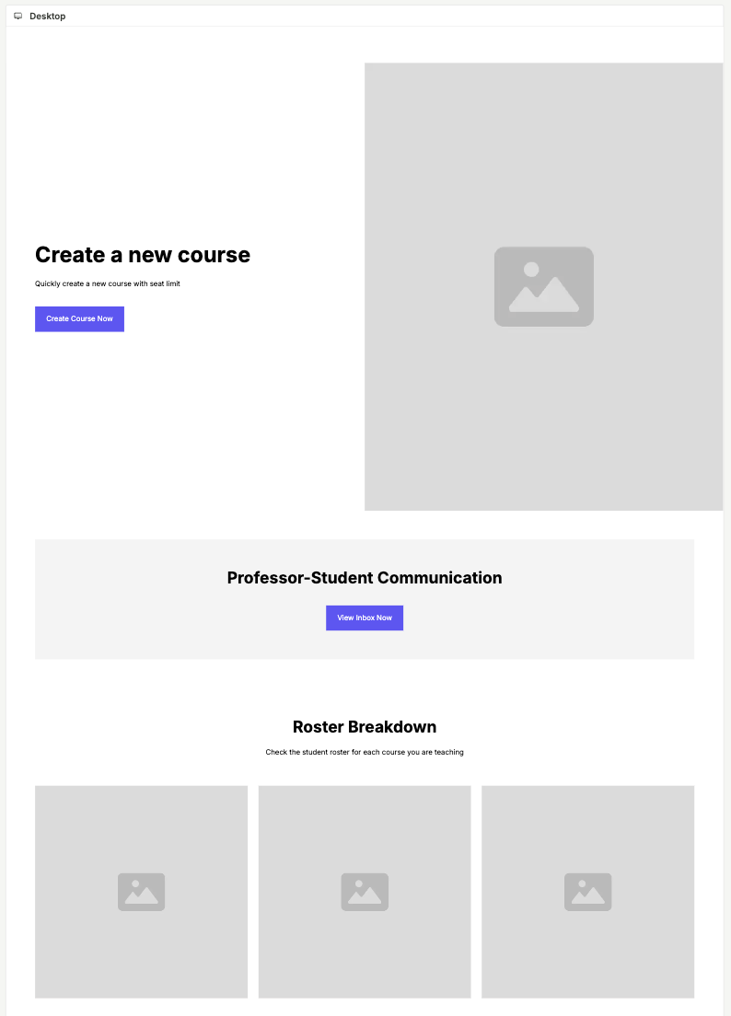
How Lernen is used by
Instructors
Course Creation - Professors can easily set up new courses.
Registered Students - Professors can see which students have enrolled into the course
Respond to student: Professors can communicate with students anonymously, ensuring privacy.
Final Notes: Lernen's straightforward, organized platform enables instructors to easily engage with students effectively.

Slide 11
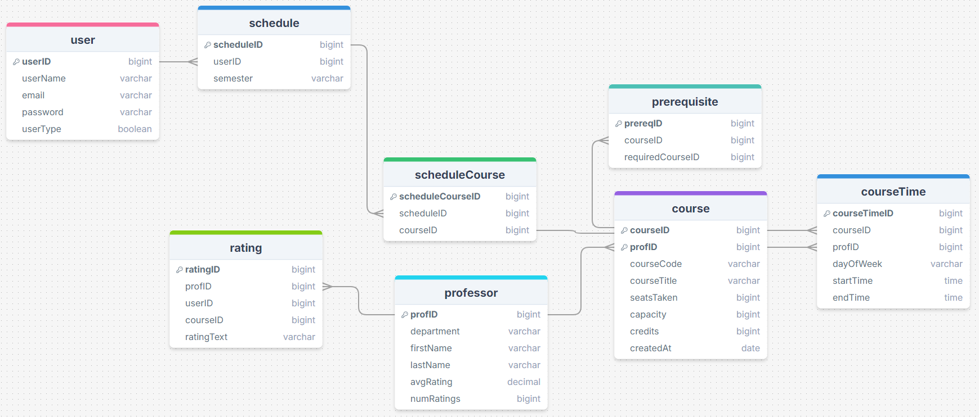

Relational Data Model

Slide 12





Tech Stack
Frontend
Server
Backend
Business Intelligence

Slide 13





Roles
Frontend
Developer
Frontend
Developer
Business Intelligence
Backend
Developer
Backend
Developer

Slide 14
Thanks for listening!
Do you have any questions?

